Slide 1
FCC3 246: CONCRETE MATERIALS
Lecture 4: WATER AND CONCRETE HYDRATION
Department of Civil & Construction Engineering
University of Nairobi
mwauras@uonbi.ac.ke

Slide 2

Mixing Water
The water used to prepare concrete must be clean and free of impurities or organic matter. Clean, drinking water is generally preferable
Any clear fresh water is acceptable
Salty water if it has to be used may lead to reduced concrete strength and may further complicate reinforcing steel use through accelerating rusting

Slide 3
Mixing Water
Water suspected to have any contaminants should be tested before use. This is the same for discoloured or smelly water before use
If dirty or muddy water MUST be used, the water should be let to settle in a drum or huge pan or tank to remove most of the dirt

Slide 4
Mixing Water
Test the water from the following sources (check BS 3148):-
Recovered water from the concrete industry
Water from underground sources
Natural surface and industrial waste water
Sea or brackish water
Treated sewage water (Raw sewage water is unsuitable)

Slide 5
Impurities
Organic impurities
Generally have early age effect
    Retardation of setting time
    Retard rate of gain of strength
Inorganic impurities
  Can cause gradual deterioration
    Sulphates attack C₃A
    Chlorides help corrode steel

Slide 6
Impurities
SALTS (in Sea and brackish water)
  Causes efflorescence
  Corrosion of reinforcement
  Drop in final strength
  Could accelerate hardening

Slide 7
Use of Water
What is the use of water in concrete manufacture?
  Water is added to cement concrete to bring about hydration of the cement
  Water also helps to lubricate the aggregates particles to help bring about the formation of the bond between aggregates and cement paste
  Water is necessary to make cement into a paste and thus render concrete workable

Slide 8
Water:Cement Ratio
Enough water is needed so that the hydration reaction is completed and the maximum strength is gained
Only a proportion of the water used actually combines chemically with the cement during the hydration process
The chemical reaction between cement and water is responsible for setting and hardening of cement concrete

Slide 9
Water:Cement Ratio
In the hydration process, excess water remains distributed within the paste. There are three main reasons for keeping this excess water to a minimum compatible with adequate workability of the concrete for the job at hand;
  Excess water in concrete may cause the cement paste to drain away from the surfaces of the aggregate particles. Depending on other factors, this may lead to defects in the fresh concrete such as poor pasting, low strength and segregation
  Excess water in concrete causes ‘bleeding’ - the tendency of excess water to rise to the surface of the freshly placed concrete. ‘Bleeding’ may form fine channels which may remain open after the concrete has hardened and this may affect its durability if it should be exposed to aggressive conditions
  Evaporation of excess water leaves voids in the paste structure, which are unlikely to be filled with solid hydrates. This in turn lowers the concrete properties such as strength, abrasion resistance, impermeability and durability. Drying shrinkage, too, is caused by loss of water from voids.
The water-cement ratio is thus of prime importance in most aspects of concrete production.

Slide 10
Water:Cement Ratio
Setting of cement concrete is the process in the stage or phase, when concrete mass changes from plastic form to a non-flowing mass
The process of gaining strength by the mass of cement concrete is known as “Hardening”.

Slide 11
Setting
False set
Flash set
Negligible evolution of heat
If re-mixed, without adding water, it becomes plastic again
It may be placed without any adverse effect
Caused by overheating during grinding
Cement paste heats up excessively
Reworking does not restore plasticity

Slide 12
Water:Cement Ratio
Mass of water divided by mass of cement
Mix design is based on this relationship to determine the strength
Higher W:C the lower the strength
  Free water: Water in mix not absorbed by aggregates
  Total water: Total amount of water in mix including that absorbed by aggregates
  Added water: Water not contained in aggregates

Slide 13
Free Water Content
Example to calculate free water:
  Cement content 400kg
  Water content 200kg
  Total weight of dry aggregate 1800kg (35% being fine aggregate)
  Water absorption, fine aggregate 3% by weight
  Water absorption, coarse aggregate 1% by weight
Mass of water
200kg
Total water/cement ratio =
=
= 0.5
Mass of cement
400kg

Slide 14
Free Water Content (continued)
Free water/cement ratio:
  coarse aggregate content = 65% of 1800 = 1170kg
  fine aggregate content = 35% of 1800 = 630kg
  Absorption, coarse aggregate = 1% of 1170 = 11.7kg
  Absorption, fine aggregate = 3% of 630 = 18.9kg
Total absorbed water = 11.7 + 18.9 = 30.6kg
Water available for hydration = 200 – 30.6 = 169.4kg
169.4kg
Free water/cement ratio =
= 0.42
400kg

Slide 15
Composition
Cement content of 1 cubic metre is usually between 100 kg/m³ and 500 kg/m³
Mass of natural aggregates (coarse and fine) is between 1800 kg/m³ and 2000 kg/m³
Free water or effective water content between 130 kg/m³ and 230 kg/m³.

Slide 16
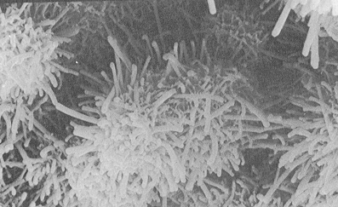
Hydration of cement
Cement goes into solution when in contact with water
Gel (Calcium silicate hydrate) (CSH) grows on surface
Calcium Hydroxide - Ca(OH)₂ - also forms crystals (not for strength)
Water is consumed by the chemical reaction
Hydration of the aluminates causes the setting and stiffening

Slide 17
Hydration of cement
<number>
Approximately 3 hour dormant period (caused by gypsum)
Rate then increases rapidly
Hydration continues as long as there is water/moisture
Heat and rate of hydration are reduced with less C₃A and C₃S
Fine cements react more quickly

Slide 18
Hydration of cement at 12 days

Slide 19
Rate of heat evolution
Ettringite formation
Dormant period
Heat
Rapid CSH gel
Final set
Initial set
Minutes
Hours
Days

Slide 20
Curing
Only occurs in the presence of moisture
Influenced by temperature:
  Increase with higher temperature
  Can stop at very low temperatures
Curing is important:
  Ensures strength development
  Causes impermeability
  Durability

Slide 21
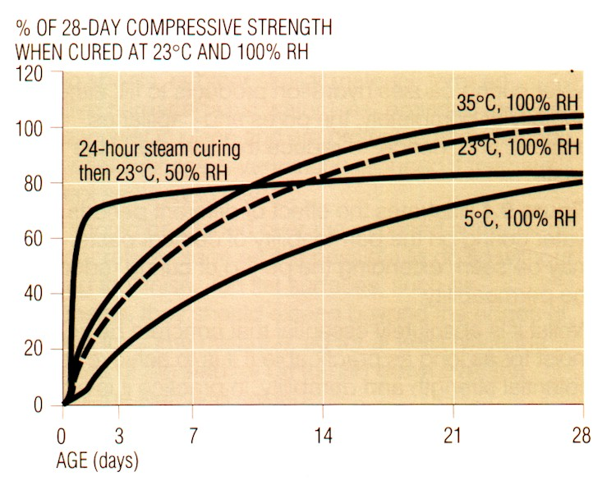
Curing
Description
  Promotion of hydration
    Control moisture
    Control temperature
  Need 80% humidity in pores for hydration

Slide 22
Factors Affecting Temperature Rise
Cement type & content
Concrete temperature when mixed
Mix proportions
Aggregate type
Concrete thickness & formwork type
Ambient Temperature, wind & relative humidity

Slide 23

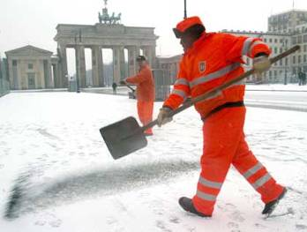
Temperature
  Higher temperature causes faster hydration
  Lower temp at casting may eventually give higher strengths
  In summer concrete achieves higher early strengths
  Low ambient temperatures will result in slower strength growth

Slide 24
Composition
One cubic metre of typical structural concrete contains approximately 2400 kg of materials. Therefore the density of most concrete is between 2300 kg/m³ and 2500 kg/m³ whilst the density of water is only 1000 kg/m³
Precise density depends on the weight of the aggregate, cement content and the water content

Slide 25

Feedback
feedback

